Slide 2
Heat Transfer from Extended Surfaces

Slide 4
one-dimensional conditions
temperature is uniform across
the fin thickness
thermal conductivity is constant
radiation from the surface is
negligible
heat generation effects are absent
convection heat transfer coefficient
is uniform over the surface

Slide 5
general form of the energy equation for an extended surface

Slide 7
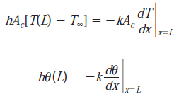

Slide 12





Fin Performance
ratio of the fin heat transfer rate to the heat transfer rate that would exist without the fin

Slide 13
Overall surface efficiency

